Slide 1
Enumerating software security design flaws throughout the SSDLC
John M. Willis
Turnaround Security, Inc.
October 5, 2016
23rd International Computer Security Symposium
and
8th SABSA World Congress
Killashee House
Naas, Ireland
© 2016 Turnaround Security, Inc., All Rights Reserved

Slide 2
Speaker Background
Security architect/engineer with a history of electronics engineering, programming, and configuration management.
First computer was a wire-wrap Z80 board programmed in assembly.
Nowadays, seeks to build security in by coming up with new and different ways of doing things.
Long list of security certifications including:
Stanford University, Advanced Computer Security Professional
Certified Secure Software Lifecycle Professional (CSSLP)
CISSP-ISSAP (Information Systems Security Architecture Professional)
Notes:
Note that terminology may not be aligned with SABSA

Slide 3
Acknowledgments
Mike Willis has helped by creating the prototype Ruby application code for the Qt-based GUI that uses neo4j-core to interface to the Neo4j database
An un-named esteemed Informatics professor who highly recommended we use Neo4j

Slide 4
Theory
By employing the methodology/tool described here, we should:
Be able to establish order where there is currently chaos regarding the identification and satisfaction of security requirements
Not only in the solution space—but throughout the Secure Software Development Life Cycle (SSDLC) as well.
Notes:
Make sure you have had your coffee, tea, or Guinness

Slide 5
This is a Work In Progress
Will provide background information
Reason for creating – lack of security engineering formal discipline
Initial Proof of Concept, Prototype
Specify requirements for an application security requirements modeling tool
Mock-ups for screens
Progress to-date on screens
Progress on graph database backend
Path forward to include community developed requirements and threat libraries
Low level technical security requirements/controls—not at code level (almost, though)

Slide 6
This Tool Will Go from This …
Add web user TLS connection during the architecture and design process
OR
Add web user TLS connection to mitigated Man-in-the-Middle (MITM) threat modeling finding
Notes:
Tool will allow input during architecture and design process, or threat modeling process.
For example, adding a TLS connection as the input will result in …

Slide 7
To This … Summary of Requirements for TLS Connection
- Key distribution | - Behavior when security attributes expire
- Secure back-end connections | - Define & maintain roles
- Confidentiality, integrity & availability | - Associate users with roles
- Replay protection | - Provide reliable time stamps
- Error recovery | - Scope session security attributes
- Authentication failure behavior | - Limit concurrent sessions
- Permitted pre-authentication actions | - Inactivity lock/unlock behavior
- Prevent & detect authentication forgery | - Inactivity session termination
- Prevent & detect use of copied authentication data | - Segmentation of different types of communication (e.g., user vs. admin)
- Different privileges of local vs. remote users | - Specify which endpoints initiate connection
- Limit authentication feedback | - Deny session based on attributes
- Control who can change security attributes | - Force re-authentication when needed - Key destruction
Notes:
… this more detailed list of requirements to consider…
We will come back to this slide later…

Slide 8
What Makes it Different &Who Would Use It
This tool would facilitate capture of detailed architecture and design requirements during the solution phase of a project, and enable testing and documentation of those requirements
Facilitate enumeration of requirements using a user configurable library of hierarchical security requirements packages, and standardized Threat Model taxonomy with mitigating controls.
The requirements library and taxonomy could be community developed
Initially, security architects / engineers and consultants would use the tool
Ultimately, it should be simple enough for developers to use

Slide 9
Brief History of Security Engineering
Once upon a time there was a lot of interest in Security Engineering as a scientific discipline even in the commercial sector
Then, COTS products began to evolve and they filled a gap—whether completely or not
Build vs. Buy cost trade-off considerations
Business pushed back and dropped support for applying full Security Engineering (except perhaps with Defense security)
As a result, at least in non-research circles, we do the best we can with the COTS products we are given – leaving gaps that may or may not be addressed
Security Engineering as a formal discipline does not exist
Notes:
Let’s back up a little bit in time…
Repeat last bullet – Security Engineering is NOT a formal discipline – yet.

Slide 10
Requirements & Security
Operating Environment / Concept of Operations
Business Requirements
Security Functional Requirements
(Security) Non-Functional Requirements
Drivers:
Users
Law/Regulations
Organizational Policy
Risk Assessments are performed inconsistently, at varying levels of depth – or not at all
Not everyone includes misuse and abuse cases
Notes:
So, let’s jump right in. Software development starts with Requirements. We have to take into consideration…

Slide 11
Solution Space Security Engineering Challenges
Code has vulnerabilities originating from various sources
About 1/3rd of all Common Weaknesses and Enumerations (CWEs) fall into the category of Design Errors – This is significant
Nonfunctional security requirements often do not get translated into real/documented technical security design features, or controls
Security design features have their own dependencies
Threat Modeling approaches are often subjective and may or may not uncover the above
Relevant technical security controls often do not get considered in Unit, Integration or QA test cases
Notes:
Now let’s focus on the solution space challenges.

Slide 12
Common Criteria Security Functional Requirements
Common Criteria is an international framework for certifying that products are secure within a specific environmental context
This talk has nothing to do with certifying products
It has a detailed list of 134 Security Functional Requirements
These requirements have dependencies on each other
We are repurposing these requirements as a starting point for a standardized security requirements library
Notes:
Level set

Slide 13
Uncommon Body of Knowledge – Modeling Research
We have had code generation from CASE tool models for decades, yet today only 4% of code is automatically generated using these tools
UMLsec has been around for at least 10 years, but requires significant effort to utilize properly (XML with security expressed in equation form), and coverage is limited
A significant body of research exists for reusing the Common Criteria Security Functional Requirements (CC SFRs)
There has been work to integrate the CC SFRs and UMLsec
Security patterns and pattern languages exist at various levels of abstraction for architecture as well as for design. Use is limited to very large organizations
There is a distinct lack of integration & automation between modeling tools & techniques used at various stages of the development lifecycle
Notes:
What do we have to work with? What has been done in researching this?

Slide 14
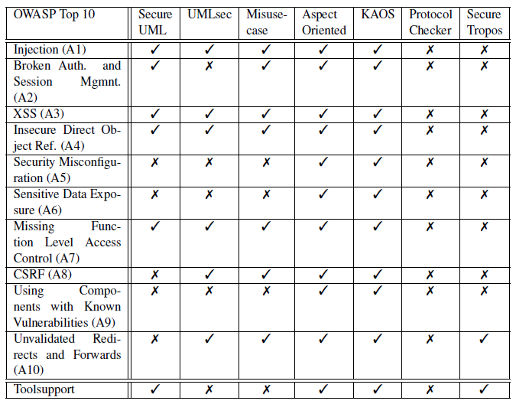
Modeling Capabilities vs. OWASP Top 10
Source: Why Model Driven Security will not secure your Web Application Hochreiner, et al. Journal of Wireless Mobile Networks, Ubiquitous Computing, and Dependable Applications, volume: 5, number: 3, pp. 44-62
Notes:
Aspect is concerned with cross-cutting issues. There has been some progress at integrating security concerns into low level UML models.
KAOS modeling is generally used for requirements engineering at a high level for business requirements.

Slide 15
Current State of Insecurity Engineering
There is no commonly accepted complete standard security engineering maturity model (merge SSE-CMM, now ISO/IEC 21827:2008, & BSIMM). Then there’s NIST SP 800-160 (Draft)
Misuse/abuse cases not always specified, not complete in coverage
Security pattern modeling is still early-stage and there are few, if any, open source UML repositories (do you know of any?)
Security engineering modeling needs to flow from architecture & design pattern models in order to achieve significant adoption
There is little SDLC end-to-end modeling integration even for systems engineering tools… everything is market-driven…
Different tools/methods exist in various stages of maturity
A number of tools/methods are inexact, incomplete, and must be applied in a subjective manner to be effective (e.g., Threat Modeling)
Threat Modeling is a Best Practice that is not widely implemented
Notes:
So… what is our current state?
Systems Security Engineering Capability Maturity Model / Build Security In Security Model
Systems Security Engineering - An Integrated Approach to Building Trustworthy Resilient Systems

Slide 16
Architect / Design / Solution Space Activities
Design of security functionality and features to implement non-functional security requirements
A Security Architect &/or Engineer should be on board to allocate & develop technical security controls for all requirements
Control requirements should accompany security architecture and design patterns
Technical security requirements that are addressed need to be captured for testing and documentation purposes
Need a formal discipline for the security engineer to follow
Security engineering methods, which must be well defined, need to be applied consistently and completely – there needs to be a formal discipline
Notes:
What do we need in the architecting & design, or solution phase?

Slide 17
Unit, Integration & QA Testing of Security
Testing should have the following inputs for test planning and test case design:
Requirements
Need to be complete—including requirements enumerated during the architecture and design phase
We cannot rely on the Requirements document to provide everything we need
Security Architecture & Design Patterns
Threat Model
Security Assessment
These should always be included, so we do not have gaps
Notes:
How we should be testing security? We need the following inputs

Slide 18
How to Establish Order from Chaos
Identify key factors
Identify those which are highly variable
Characterize (describe) these highly variable key factors as well as contributing variables
Control the factors that affect variability

Slide 19
Variables to Capture, Characterize & Control
Identify what information assets you are trying to protect
Technical security controls flowing from Requirements
Allocation of design to technical security controls, including nonfunctional security requirements (solution space)
Design phase Threat Modeling and resulting mitigations (lead to new technical security controls) (solution space)
Mitigations from Security/Risk Assessments (from various SSDLC phases)
Notes:
What are the relevant variables?

Slide 20
Variables to Capture, Characterize & Control (cont’d)
Security requirements dependencies
Risk-Benefit Analysis of each security requirement
Which technical security controls should be implemented?
Which technical security controls are being, or should be, tested?
Doing so will facilitate determining which technical security controls are missing from our design in a reproducible manner
Notes:
What are the relevant variables?

Slide 21
Reusing Common Criteria (CC) Security Functional Requirements (SFRs)
There is an established body of literature pertaining to the reuse of Common Criteria Security Functional Requirements. This is a good starting point
Dependencies exist between different SFRs, so this helps us expand what we think our controls are into something more comprehensive
But where do we start?
Dan Wu doctoral thesis SFR Reusable Packages. Security Functional Requirements Analysis for Developing Secure Software, Doctoral Thesis, Dan Wu, May 2007
Security Tactics and Goals. Preschern, C. 2012. Catalog of Security Tactics linked to Common Criteria Requirements.

Slide 22
TLS Use Case
From this point forward, we will provide examples of security functional requirements relating to implementation of Transport Layer Security (TLS)

Slide 23
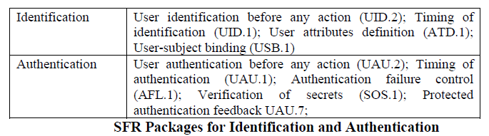
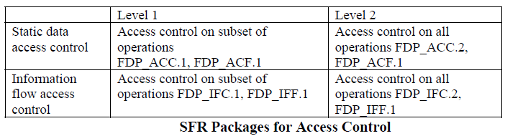

SFR Reusable Packages – Security Requirements Packages
Notes:
Different types of applications/domains have different statistical distributions of the SFRs.
Note complete codes such as for Access control FDP_ACC.1.

Slide 24
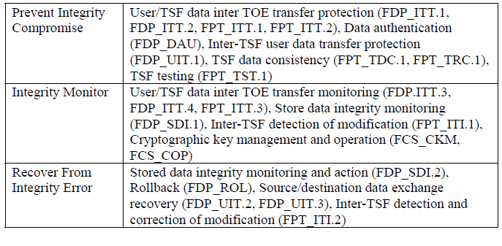
Security Requirements Packages (cont’d)
SFR Packages for Integrity
Source: Wu, D. (2007). Security Functional Requirements Analysis for Developing Secure Software (Doctoral dissertation)
Notes:
Who says the package is right? The security architect.
Packages are standardized based on type of platform.
During architecture and design phase certain requirements may be excluded based on specific requirements, deign and environment.

Slide 25
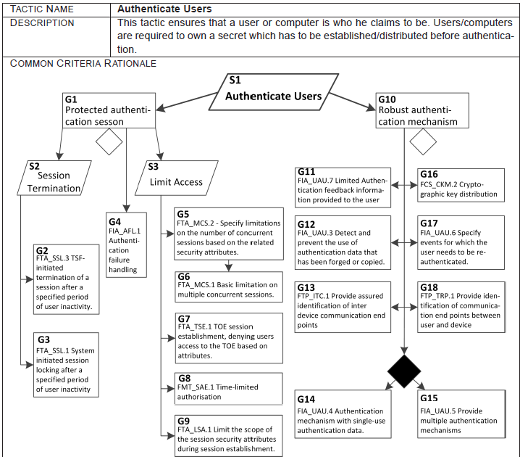
Security Tactics & Goals – Authenticate Users
Notes:
Next three slides are just a subset of Preschern’s work. S=Strategy; G=Goal. Note S2, S3 & G10
Note decision diamond (2FA vs single factor). Has to be accommodated by tool. Not yet, though.

Slide 26
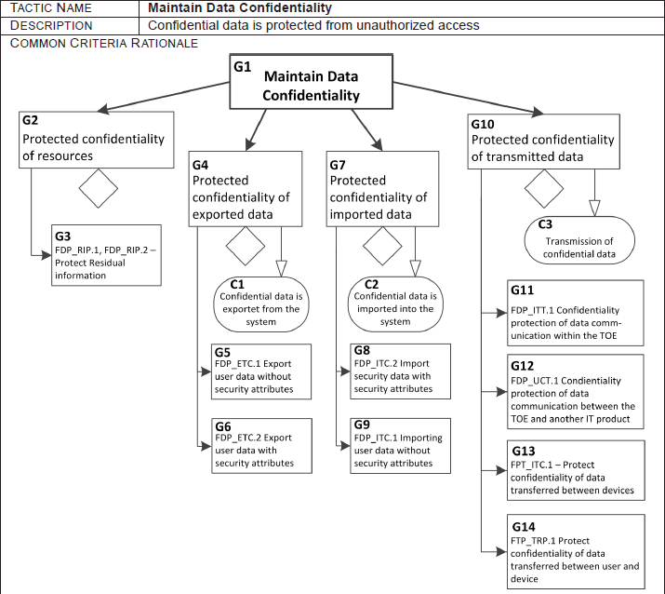
Security Tactics & Goals – Confidentiality
Source: Preschern, C. 2012. Catalog of Security Tactics linked to Common Criteria Requirements.
Notes:
Selection of the applicable goals is a function of what you are trying to do and the environment (i.e., use case).
These are more broad and not as specific as Wu’s. Point is that there are rational ways to form SRPs.
Only G10 (Confidentiality of Transmitted information) relates to TLS

Slide 27
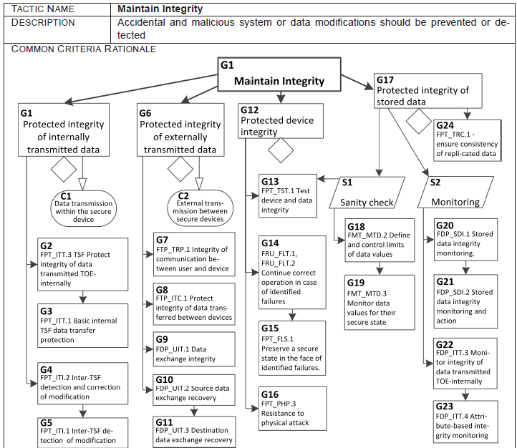
Security Tactics & Goals – Integrity
Notes:
Later we will include G6 for our TLS connection

Slide 28
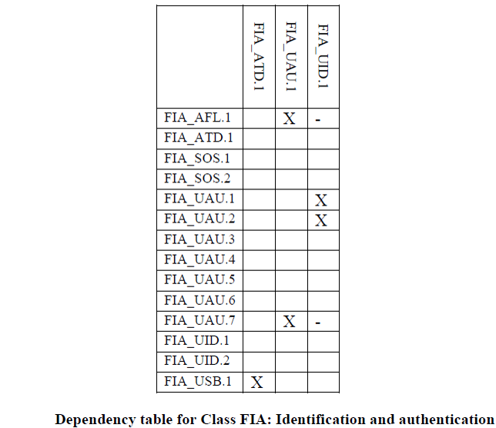
CC SFR Dependency Tables (example)
Source: Common Criteria for Information Technology Security Evaluation (CC v3.1), Revision 2, Part 2: Security functional components.
Notes:
An “O” in a cell means Optional, based on a decision using information
A “-” means it is required indirectly. So far, we have not included optional or indirect requirements in the imported data

Slide 29
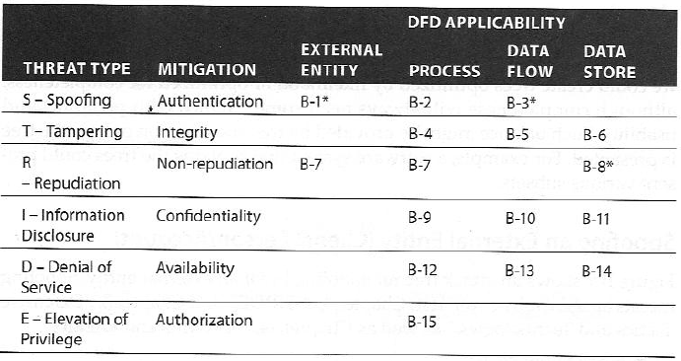
STRIDE Based Threat Modeling
Source: Adam Shostack. Threat Modeling: Designing for Security. John Wiley & Sons, Inc., 2014
Notes:
Note use of STRIDE and DFD… We are going to focus on Spoofing Authentication from an External Entity (client).
Note: B-#s refer to sections in Appendix B.

Slide 30
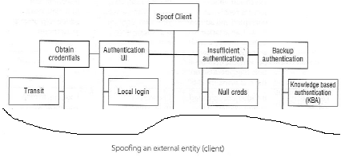
Spoof Client Threat Tree (Partial)
(B-1)
Source: Adam Shostack. Threat Modeling: Designing for Security. John Wiley & Sons, Inc., 2014
Notes:
Entire tree is one possible starting point for a complete taxonomy. Each of these boxes can be encoded, or codified …

Slide 31
Codifying Standard Threat Model (Example)
Spoof.Client
Spoof.Client.AuthenticationUI
Spoof.Client.AuthenticationUI.LocalLogin
Spoof.Client.AuthenticationUI.PrivilegedAccess
Spoof.Client.AuthenticationUI.RemoteSpoof
Spoof.Client.BackupAuthentication
Spoof.Client.BackupAuthentication.ChainedAuthentication
Spoof.Client.BackupAuthentication.InformationDisclosure
Spoof.Client.BackupAuthentication.KnowledgeBasedAuthentication
Spoof.Client.InsufficientAuthentication
Spoof.Client.InsufficientAuthentication.DowngradeAuthentication
Spoof.Client.InsufficientAuthentication.NullCreds
Spoof.Client.InsufficientAuthentication.PredicatbleCreds
Spoof.Client.NoAuthentication
Spoof.Client.ObtainCredentials
Spoof.Client.ObtainCredentials.ChangeManagement
Spoof.Client.ObtainCredentials.FederationIssues
Spoof.Client.ObtainCredentials.Storage
Spoof.Client.ObtainCredentials.Storage.at3rdParty
Spoof.Client.ObtainCredentials.Storage.atClient
Spoof.Client.ObtainCredentials.Storage.atKDC
Spoof.Client.ObtainCredentials.Storage.atServer
Spoof.Client.ObtainCredentials.Transit
Spoof.Client.OtherAuthenticationAttack
Derived from Source: Adam Shostack. Threat Modeling: Designing for Security. John Wiley & Sons, Inc., 2014
Notes:
And here is Spoof Client. For each of these threats there are mitigations to consider. We are going to focus on Obtain Credentials in Transit

Slide 32
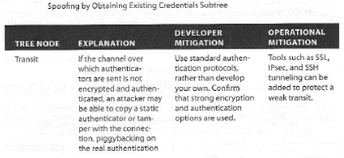
Standardizing Threat Mitigations (Example)
(B-1)
Source: Adam Shostack. Threat Modeling: Designing for Security. John Wiley & Sons, Inc., 2014
Notes:
Encryption & authentication needed. Mitigation options include SSL, IPsec & SSH. Because we are working with a web app SSL (TLS) applies.
The tool mayneed to have some context awareness.

Slide 33
Standardized Tool-Based Threat Modeling
Context needed in certain cases (External Entity, Process, Data Flow, Data Store, Security Requirements Package selection & options)
Tool should know what type of connection it is based on context (e.g., TLS for a web app)
Define a standardized taxonomy (e.g., using Threat Trees), codify them, along with mitigations based on context
Define your model – start somewhere and build from there
Always ensure all attacks are accounted for when you are performing your threat modeling
Notes:
The key point is to standardize your threat modeling taxonomy – start somewhere. Standardize your process to minimize subjectivity.
Findings, impact, LOE are outputs of Threat Modeling. This tool would assist in managing threat information and matching it up with mitigations.

Slide 34
Proof of Concept
Very rough shell script version
Threat Modeling – concern about a web application user login and man-in-the-middle attack -- recommended mitigation of SSL (TLS)
Does not include navigation via Threat Tree to select mitigation
User authentication, confidentiality of password and integrity of data are the applicable Goals/Tactics (Security Requirements Packages)
For illustrative purposes, we’re not going to show the Requirements document as a source of input

Slide 35
Proof of Concept – Threat Modeling Input
Enter Project Name: POC
Enter Location Reference: userLogon1
Select Location Type [1]:
1 - External Entity
2 - Process
3 - Data Flow
4 - Data Store
1
Security Requirements Packages to Apply
1 - Authenticate Users: Robust authentication mechanism
2 - Authenticate Users: Protected authentication session
3 - Authenticate Users: Protected authentication session: Session Termination
4 - Authenticate Users: Protected authentication session: Limit Access
5 - Maintain Data Confidentiality: Protected confidentiality of transmitted data
6 - Maintain Integrity: Protected integrity of externally transmitted data
Enter list of goals (numbers separated by space): 1 2 3 4 5 6
Generating list of requirements...

Slide 36
Requirements Output
Result is 26 unique Common Criteria Security Functional Requirement statements, e.g.:
FCS_CKM.2: The TSF shall distribute cryptographic keys in accordance with a specified cryptographic key distribution method [assignment: cryptographic key distribution method] that meets the following: [assignment: list of standards].
FCS_CKM.4: The TSF shall destroy cryptographic keys in accordance with a specified cryptographic key destruction method [assignment: cryptographic key destruction method] that meets the following: [assignment: list of standards].
TSF = TOE (Target of Evaluation) Security Functions
Notes:
Here we have two examples – creation and destruction of keys.
Note the presence of the brackets. Your organization would tailor these in the requirements library based on your standards and preferred methods.

Slide 37
All TLS SFRs
Primary SFRs | Secondary SFRs | Tertiary SFRs
FCS_CKM.2 | FCS_CKM.4
FDP_ITT.1
FDP_UCT.1
FDP_UIT.1
FDP_UIT.2
FDP_UIT.3
FIA_AFL.1 | FIA_UAU.1 | FIA_UID.1
FIA_UAU.3
FIA_UAU.4
FIA_UAU.6
FIA_UAU.7 | FIA_UAU.1 | FIA_UID.1
FMT_SAE.1 | FMT_SMR.1, FPT_STM.1 | FIA_UID.1
FPT_ITC.1
FTA_LSA.1
FTA_MCS.1 | FIA_UID.1
FTA_MCS.2 | FIA_UID.1
FTA_SSL.1 | FIA_UAU.1
FTA_SSL.3
FTA_TSE.1
FTP_ITC.1
FTP_TRP.1
Notes:
For our purposes, we’ll refer to these as Primary, Secondary and Tertiary SFRs. The Primary SFRs are specified in the SRPs that were selected.
11 instances of dependent requirements. 5 unique secondary requirements, and 1 unique tertiary requirement.

Slide 38
Summary of Requirements for TLS Connection
- Key distribution | - Behavior when security attributes expire
- Secure back-end connections | - Define & maintain roles
- Confidentiality, integrity & availability | - Associate users with roles
- Replay protection | - Provide reliable time stamps
- Error recovery | - Scope session security attributes
- Authentication failure behavior | - Limit concurrent sessions
- Permitted pre-authentication actions | - Inactivity lock/unlock behavior
- Prevent & detect authentication forgery | - Inactivity session termination
- Prevent & detect use of copied authentication data | - Segmentation of different types of communication (e.g., user vs. admin)
- Different privileges of local vs. remote users | - Specify which endpoints initiate connection
- Limit authentication feedback | - Deny session based on attributes
- Control who can change security attributes | - Force re-authentication when needed - Key destruction
Notes:
Would you think to address all of these? How about “Deny session based on attributes”? Did you check revocation status of the client certificate?
Some of these may not apply to a TLS connection, per se, but you may still need to take them into consideration. For example, how to know what role the user has.

Slide 39
What We Demonstrated
For a given component type (reusable security function), you can specify applicable groupings of security requirements (SRPs)
Each SRP can be configured as a set of detailed requirements
They can include dependent requirements
We can associate Threat Modeling mitigations to standardized requirements packages—and their dependencies
We can expand the list of requirements for later use

Slide 40
Requirements for a Complete Tool
The high-level re-entrant workflow concept to be used throughout the Secure Software Development Lifecycle (SSDLC) includes:
Build the security model –
Direct input of instance of security component
Select component by way of threat model taxonomy
Expand the requirements utilizing a configurable library of Security Requirements Packages, plus their dependencies
Design status check-off of items already addressed, or inherited
Enter level of effort and risk scoring data and provide a Risk-Benefit Analysis ranking
Notes:
What are the requirements for a complete tool?

Slide 41
Requirements for a Complete Tool (cont’d)
Risk decision step to fix or accept risk, documenting any risk acceptance justification
Document any items deferred
Generate list of security requirements changes to be addressed, and update design status as fixed
Output list of all security requirements implemented, or being implemented, for documentation and testing purposes
Output list of implemented, inherited, and deferred security controls in desired format (ISO or NIST)

Slide 42
Create
Model
Builder
Expand Requirements
Design Status
Risk-Benefit-Analysis
Risk Decision
Requirements Change Checklist
Finalize Requirements
Output Test Requirements
Output Security Controls
Select Application Type
Desktop
Mobile
Server
Web
Application Name
Demo
Notes:
Create: Application Type: Web, Desktop, Server, Mobile

Slide 43
Create
Model
Builder
Expand Requirements
Design Status
Risk-Benefit-Analysis
Risk Decision
Requirements Change Checklist
Finalize Requirements
Output Test Requirements
Output Security Controls
New Component
User
Server
Input Mode
Threat Model
Direct
Component Name
userLogon1
Component Type
User
Server
TLS
Many more to follow…
Notes:
Mock-up: Chose Direct Input Mode for architecture and design activities, or Threat Model for Threat Model data input. Here we choose Direct.
This screen is a DFD view, with only instances of node types visible.

Slide 44
Create
Model
Builder
Expand Requirements
Design Status
Risk-Benefit-Analysis
Risk Decision
Requirements Change Checklist
Finalize Requirements
Output Test Requirements
Output Security Controls
New Component
User
Server
Input Mode
Threat Model
Direct
Component Name
userLogon1
Location
External Entity
Process
Data Flow
Data Store
Spoof Client
Obtain credentials
Authentication UI
No authentication
Other authentication attack
Insufficient authentication
Backup authentication
Obtain Credentials
Transit
Change management
Federation issues
Storage
Mitigation
SSL
IPsec
TLS
Other
Notes:
Mock-up: Example Threat Tree navigation for Threat Model Input Mode.
Need to add DFD borders? Repeat: Two different input modes: Direct for design, and Threat Model

Slide 45
Create
Model
Builder
Expand Requirements
Design Status
Risk-Benefit-Analysis
Risk Decision
Requirements Change Checklist
Finalize Requirements
Output Test Requirements
Output Security Controls
Security Functional Requirements
Component Type: TLS
 | Used by: userLogon1 userLogon2
 |  | The TSF shall be able to deny session establishment based on [assignment: attributes]. [FTA_TSE.1]
 |  | The TSF shall enforce the [assignment: access control SFP(s) and/or information flow control SFP(s)] to be able to [selection: transmit, receive] user data in a manner protected from unauthorised disclosure. [FDP_UCT.1]
 |  | The TSF shall enforce the [assignment: access control SFP(s) and/or information flow control SFP(s)] to be able to recover from [assignment: list of recoverable errors] with the help of the source trusted IT product. [FDP_UIT.2]
 |  | The TSF shall enforce the [assignment: access control SFP(s) and/or information flow control SFP(s)] to prevent the [selection: disclosure, modification, loss of use] of user data when it is transmitted between physically-separated parts of the TOE. [FDP_ITT.1]

Slide 46
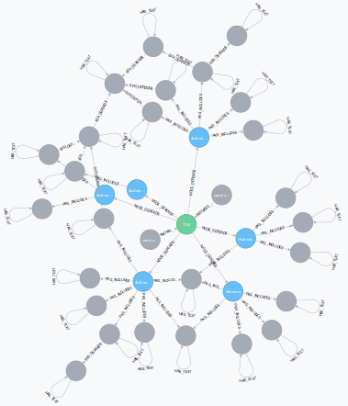
Neo4j Graph Database
Notes:
userLogon1 & userLogon2

Slide 47
Create
Model
Builder
Expand Requirements
Design Status
Risk-Benefit-Analysis
Risk Decision
Requirements Change Checklist
Finalize Requirements
Output Test Requirements
Output Security Controls
Security Functional Requirement Component Type: TLS; Used by: userLogon1, userLogon2 | Already Implemented
The TSF shall prevent reuse of authentication data related to [assignment: identified authentication mechanism(s)]. [FIA_UAU.4]
The TSF shall re-authenticate the user under the conditions [assignment: list of conditions under which re-authentication is required]. [FIA_UAU.6]
The TSF shall enforce the [assignment: access control SFP(s) and/or information flow control SFP(s)] to be able to recover from [assignment: list of recoverable errors] with the help of the source trusted IT product. [FDP_UIT.2]
The TSF shall enforce the [assignment: access control SFP(s) and/or information flow control SFP(s)] to prevent the [selection: disclosure, modification, loss of use] of user data when it is transmitted between physically-separated parts of the TOE. [FDP_ITT.1]
Y
Y

Slide 48
Create
Model
Builder
Expand Requirements
Design Status
Risk-Benefit-Analysis
Risk Decision
Requirements Change Checklist
Finalize Requirements
Output Test Requirements
Output Security Controls
Security Functional Requirement Component Type: TLS; Used by: userLogon1, userLogon2 | Risk | LOE | Ranking
The TSF shall be able to deny session establishment based on [assignment: attributes]. [FTA_TSE.1] | M | $ 50,000 | 10
The TSF shall enforce the [assignment: access control SFP(s) and/or information flow control SFP(s)] to be able to [selection: transmit, receive] user data in a manner protected from unauthorised disclosure. [FDP_UCT.1] | H | $ 20,000 | 50
The TSF shall enforce the [assignment: access control SFP(s) and/or information flow control SFP(s)] to be able to recover from [assignment: list of recoverable errors] with the help of the source trusted IT product. [FDP_UIT.2] | L | $ 30,000 | 3
The TSF shall enforce the [assignment: access control SFP(s) and/or information flow control SFP(s)] to prevent the [selection: disclosure, modification, loss of use] of user data when it is transmitted between physically-separated parts of the TOE. [FDP_ITT.1] | M | $ 30,000 | 17
Notes:
Ranking is basically a product of Risk x inverse of Cost to Fix
The higher the Ranking the higher the priority to fix

Slide 49
Create
Model
Builder
Expand Requirements
Design Status
Risk-Benefit-Analysis
Risk Decision
Requirements Change Checklist
Finalize Requirements
Output Test Requirements
Output Security Controls
Security Functional Requirement Component Type: TLS; Used by: userLogon1, userLogon2 | Risk | LOE | Ranking | Fix Decision
The TSF shall be able to deny session establishment based on [assignment: attributes]. [FTA_TSE.1] | M | $ 50,000 | 10
The TSF shall enforce the [assignment: access control SFP(s) and/or information flow control SFP(s)] to be able to [selection: transmit, receive] user data in a manner protected from unauthorised disclosure. [FDP_UCT.1] | H | $ 20,000 | 50 | Yes
The TSF shall enforce the [assignment: access control SFP(s) and/or information flow control SFP(s)] to be able to recover from [assignment: list of recoverable errors] with the help of the source trusted IT product. [FDP_UIT.2] | L | $ 30,000 | 3
The TSF shall enforce the [assignment: access control SFP(s) and/or information flow control SFP(s)] to prevent the [selection: disclosure, modification, loss of use] of user data when it is transmitted between physically-separated parts of the TOE. [FDP_ITT.1] | M | $ 30,000 | 17 | Yes
Notes:
This screen should be sorted by ranking

Slide 50
Create
Model
Builder
Expand Requirements
Design Status
Risk-Benefit-Analysis
Risk Decision
Requirements Change Checklist
Finalize Requirements
Output Test Requirements
Output Security Controls
Security Functional Requirement Component Type: TLS; Used by: userLogon1, userLogon2 | Risk | LOE | Ranking | Fix Decision
The TSF shall be able to deny session establishment based on [assignment: attributes]. [FTA_TSE.1] | M | $ 50,000 | 10 | Defer
The TSF shall enforce the [assignment: access control SFP(s) and/or information flow control SFP(s)] to be able to [selection: transmit, receive] user data in a manner protected from unauthorised disclosure. [FDP_UCT.1] | H | $ 20,000 | 50 | Yes
The TSF shall enforce the [assignment: access control SFP(s) and/or information flow control SFP(s)] to be able to recover from [assignment: list of recoverable errors] with the help of the source trusted IT product. [FDP_UIT.2] | L | $ 30,000 | 3
The TSF shall enforce the [assignment: access control SFP(s) and/or information flow control SFP(s)] to prevent the [selection: disclosure, modification, loss of use] of user data when it is transmitted between physically-separated parts of the TOE. [FDP_ITT.1] | M | $ 30,000 | 17 | Yes
Defer Until
Release 2.3

Slide 51
Create
Model
Builder
Expand Requirements
Design Status
Risk-Benefit-Analysis
Risk Decision
Requirements Change Checklist
Finalize Requirements
Output Test Requirements
Output Security Controls
Security Functional Requirement Component Type: TLS; Used by: userLogon1, userLogon2 | Risk | LOE | Ranking | Accept
The TSF shall be able to deny session establishment based on [assignment: attributes]. [FTA_TSE.1] | M | $ 50,000 | 10 | Defer
The TSF shall enforce the [assignment: access control SFP(s) and/or information flow control SFP(s)] to be able to [selection: transmit, receive] user data in a manner protected from unauthorised disclosure. [FDP_UCT.1] | H | $ 20,000 | 50 | Yes
The TSF shall enforce the [assignment: access control SFP(s) and/or information flow control SFP(s)] to be able to recover from [assignment: list of recoverable errors] with the help of the source trusted IT product. [FDP_UIT.2] | L | $ 30,000 | 3 | No
The TSF shall enforce the [assignment: access control SFP(s) and/or information flow control SFP(s)] to prevent the [selection: disclosure, modification, loss of use] of user data when it is transmitted between physically-separated parts of the TOE. [FDP_ITT.1] | M | $ 30,000 | 17 | Yes
Enter Justification
Not critical. Can re-initiate session
Notes:
This screen should be sorted by ranking

Slide 52
Create
Model
Builder
Expand Requirements
Design Status
Risk-Benefit-Analysis
Risk Decision
Requirements Change Checklist
Finalize Requirements
Output Test Requirements
Output Security Controls
Security Functional Requirement Component Type: TLS; Used by: userLogon1, userLogon2 | Affected Component(s)
The TSF shall enforce the [assignment: access control SFP(s) and/or information flow control SFP(s)] to be able to [selection: transmit, receive] user data in a manner protected from unauthorised disclosure. [FDP_UCT.1] | accessControl.java
The TSF shall enforce the [assignment: access control SFP(s) and/or information flow control SFP(s)] to prevent the [selection: disclosure, modification, loss of use] of user data when it is transmitted between physically-separated parts of the TOE. [FDP_ITT.1] | ldap.java

Slide 53
Create
Model
Builder
Expand Requirements
Design Status
Risk-Benefit-Analysis
Risk Decision
Requirements Change Checklist
Finalize Requirements
Output Test Requirements
Output Security Controls
TBD: Outputs requirements that are implemented, or are being implemented, as well as those that have been deferred

Slide 54
Create
Model
Builder
Expand Requirements
Design Status
Risk-Benefit-Analysis
Risk Decision
Requirements Change Checklist
Finalize Requirements
Output Test Requirements
Output Security Controls
TBD: List all requirements –
previously implemented (for regression testing purposes)
those that are being newly implemented (new test cases needed)

Slide 55
Create
Model
Builder
Expand Requirements
Design Status
Risk-Benefit-Analysis
Risk Decision
Requirements Change Checklist
Finalize Requirements
Output Test Requirements
Output Security Controls
Security Functional Requirement Component Type: TLS; Used by: userLogon1, userLogon2 | NIST
The TSF shall enforce the [assignment: access control SFP(s) and/or information flow control SFP(s)] to be able to [selection: transmit, receive] user data in a manner protected from unauthorised disclosure. [FDP_UCT.1] | SC-8, SC-8(1)
The TSF shall enforce the [assignment: access control SFP(s) and/or information flow control SFP(s)] to prevent the [selection: disclosure, modification, loss of use] of user data when it is transmitted between physically-separated parts of the TOE. [FDP_ITT.1] | SC-8, SC-8(1)

Slide 56
Create
Model
Builder
Expand Requirements
Design Status
Risk-Benefit-Analysis
Risk Decision
Requirements Change Checklist
Finalize Requirements
Output Test Requirements
Output Security Controls
Library Maintenance
Select Library
Component Type
Security Requirements Packages
Security Functional Requirements
Threat Tree
Threat Mitigations
Select Action
Import
Export
Edit

Slide 57
What Makes This Approach Unique
Assists in enumerating requirements by applying standardized Security Requirements Packages, then expanding the requirements based on well-defined dependencies
Includes chosen or default mitigations from a standardized Threat Model taxonomy & generates more detailed security requirements and controls
Enables Risk-Benefit Analysis of each security requirement/control
Facilitates generating documentation needed for testing and compliance purposes
Notes:
Let’s review

Slide 58
Benefits of Such a Methodology/Tool
Enable characterizing security variables so that they may be controlled, which is the key to establishing order from chaos
Provide a way of enumerating design flaws, errors and omissions—which may account for 1/3rd of vulnerabilities (CWEs)
Enable enumeration of security functionality
Identified in the solution space
Not detailed in the original Requirements Document
Notes:
Future tense

Slide 59
Benefits of Such a Methodology/Tool (cont’d)
Facilitate decision-making using Risk-Benefit Analysis of each technical security control, generating acceptance of risk documentation and record of deferred items
Enable us to generate details needed to implement enumerated requirements—for design and coding changes, plus unit, integration, and QA testing
Provide details for system security plans in ISO and NIST formats
Integrate with systems engineering modeling tools via SysML

Slide 60
Theory – Did we come close to proving?
Enable establishing order where there is currently chaos regarding the identification and satisfaction of security requirements during software development?
Is this approach part of what is needed to establish security engineering as a formal discipline?
Does it solve a real problem? Which one?

Slide 61
Future of this Tool
Basic functionality in prototype
Support for requirement decision-making dialogues, context inputs
Enable tailoring and completion of requirements language
Provide support for configurable standardized Threat library & associated mitigations
Make freely available as an online service
Open up Security Requirements Packages and Threat Library for community development
Three phases of development:
Standalone/online (open source/funding/partners ?)
Shared / Systems Roll-up / Performance Testing / Enterprise version
SysML-capable / Integration with other tools

Slide 62
Wrap-Up
Does this make sense?
Is it useful?
Who would use it?
Who would buy it?
Who would invest in it?
If open sourced, would anybody really work on it?
Should support for architecture and design patterns be included?
If so, when? Scope? For requirements only?
Questions & Discussion?

Slide 63
Contact Info
John M. Willis
Turnaround Security, Inc.
9841 Washingtonian Blvd
Suite 200
Gaithersburg MD 20878 USA
(240) 252-7982
John.M.Willis@TurnaroundSecurity.com
LinkedIn.com/in/johnmwillis

